Slide 1
Lecture 1: Perceptron and Back Propagation

Slide 2
Outline
Description of the course
Introduction to Artificial Neural Networks
Review of Classification and Logistic Regression
Introduction to Optimization
Gradient Descent
Stochastic Gradient Descent
Back Propagation
Single Neuron Network (‘Perceptron’)
Multi-Layer Perceptron

Slide 3
Outline
Description of the course
Introduction to Artificial Neural Networks
Review of Classification and Logistic Regression
Introduction to Optimization
Gradient Descent
Stochastic Gradient Descent
Single Neuron Network (‘Perceptron’)
Multi-Layer Perceptron
Back Propagation

Slide 4
Schedule
Six Lectures @Fridays 8:00pm EST (Pavlos Protopapas):
Introduction
Design choices for NN, number of layers, number of nodes, activation function
Solver and Regularization
Convolutional Neural Networks, basic concepts and architectures
Convolutional Neural Networks part2 and state of the art networks
Auto-encoders
Six Labs @Saturdays 8:00pm EST (David Sondak)
Six Office hours @Mondays 8:00am EST (David Sondak)
Two assignments:
To be released Oct 23 midnight, due on Oct 30th midnight
To be released Nov 13 midnight, presentations on Nov 21st 8:00pm (EST)

Slide 5

Who
Pavlos Protopapas, Scientific Director of the Institute for Applied Computational Science (IACS). Teaches CS109a, CS109b and the Capstone course for the Data Science masters program. He is a leader in astrostatistics and he is excited about the new telescopes coming online in the next few years. He loves cooking and eating.

Slide 6
Who
David Sondak, computational mathematician and lecturer at the Institute for Applied Computational Science. He teaches CS207 and extreme computing. He loves maths and dogs!

Slide 7
Policies
We encourage you to talk and discuss the assignments with your fellow students (and on Piazza), but you are not allowed to look at any other students assignment or code outside of your group (max 3).
YOU CAN SUBMIT AS A GROUP.

Slide 8
Policies
Ethical behavior is an important trait of a Data Scientist, from ethically handling data to attribution of code and work of others. Thus, in this course we give a strong emphasis to Academic Honesty. As a student your best guidelines are to be reasonable and fair. We encourage teamwork for problem sets, but you should not split the homework and you should work on all the problems together. We have included some ideas below of acceptable and not acceptable​ behaviors. Engaging in not acceptable behavior regarding academic honesty will be handled harshly. Please be responsible and when in doubt ask either Pavlos or David.

Slide 9
Policies
ACCEPTABLE​:
➔ Discussing materials and engaging in OH.
➔ Helping debug.
➔ Using a few lines of code found online or other forum as long as you cite the origin and attribute authorship of code.
➔ Searching online to expand your knowledge and for debugging, but not for outright solutions to HWs.
➔ Using a tutor, provided the tutor does not do your work for you.

Slide 10
Policies
NOT ACCEPTABLE​:
➔ Accessing a solution to some problem prior to submitting your own.
➔ Failing to cite the origins of code or techniques that you discover outside of the course’s own lessons and integrate into your own work.
➔ Paying or offering to pay an individual for work that you may submit as your own.
➔ Providing or making available solutions to problem sets to individuals who might take this course in the future.
➔ Searching for or soliciting outright solutions to problem sets online or elsewhere.
➔ Splitting a problem set’s workload with another individual and combining your work.

Slide 11
Outline
Description of the course
Introduction to Artificial Neural Networks
Review of Classification and Logistic Regression
Introduction to Optimization
Gradient Descent
Stochastic Gradient Descent
Back Propagation
Single Neuron Network (‘Perceptron’)
Multi-Layer Perceptron

Slide 12
Watch this!
http://video.arstechnica.com/watch/sunspring-sci-fi-short-film

Slide 13
Artificial Neural Networks

Slide 14

Today’s news

Slide 15
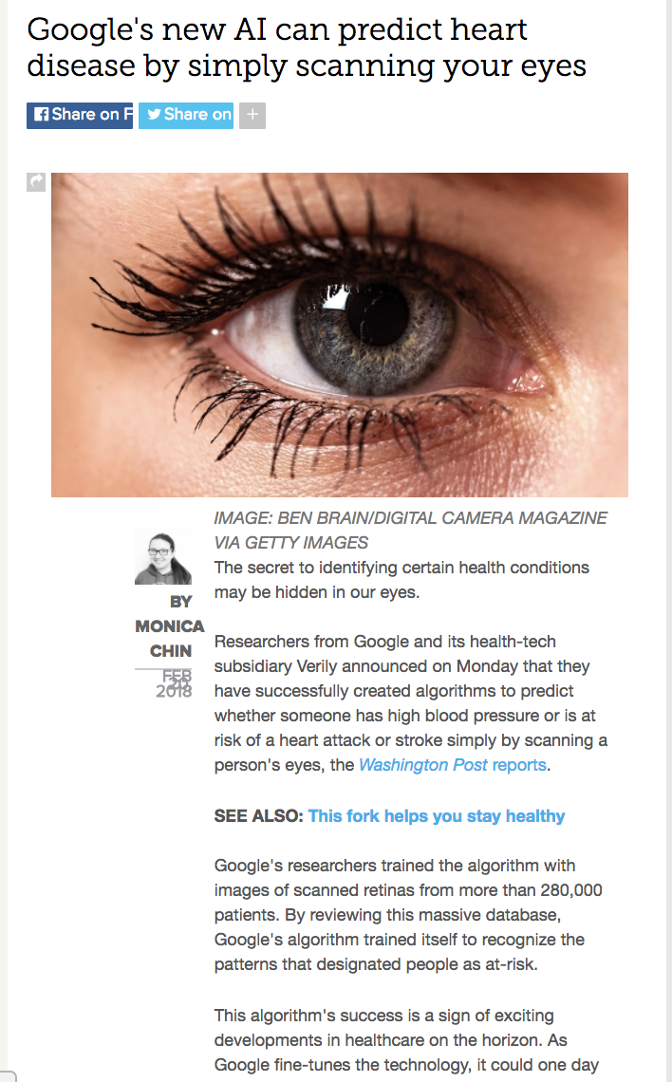
Today’s news

Slide 16
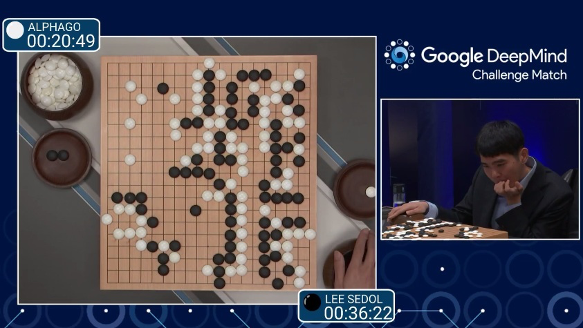
AlphaGo (2015)
First program to beat a professional Go player
Notes:
https://www.youtube.com/watch?v=PQCrX1sQSzY

Slide 17
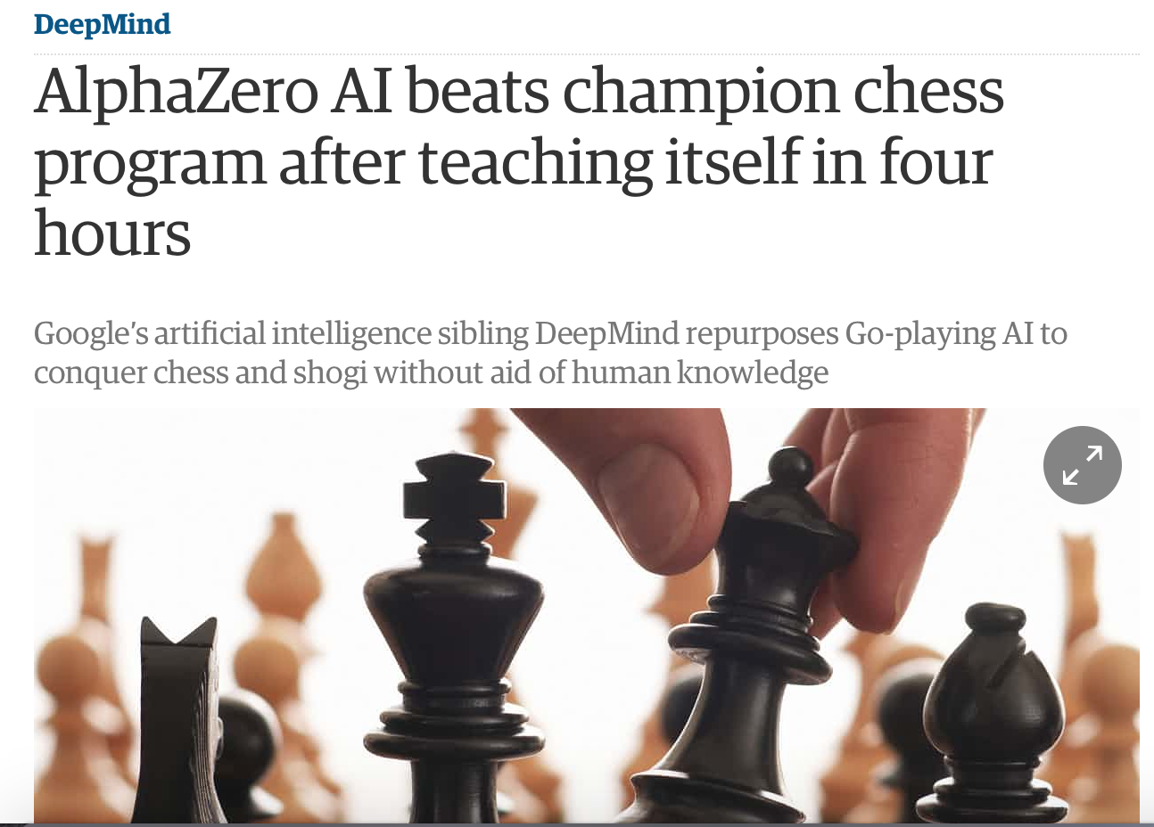
AlphaZero (2017)

Slide 18
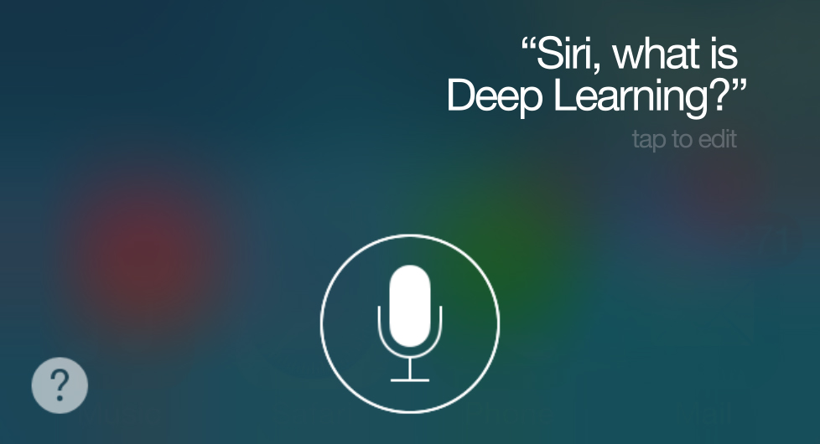
iOS Speech Synthesis (2016-)
Trained from 20 hours of high quality speech
machinelearning.apple.com
Notes:
https://machinelearning.apple.com/2017/08/06/siri-voices.html

Slide 19
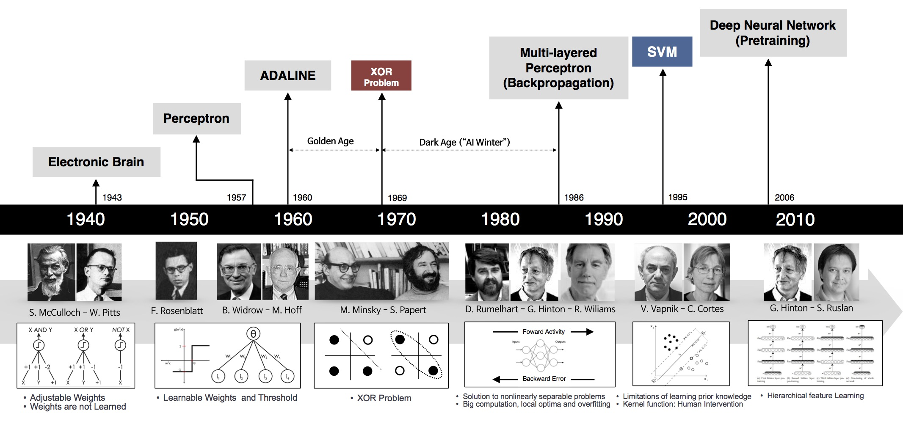
Historical Trends
beamandrew.github.io/

Slide 20
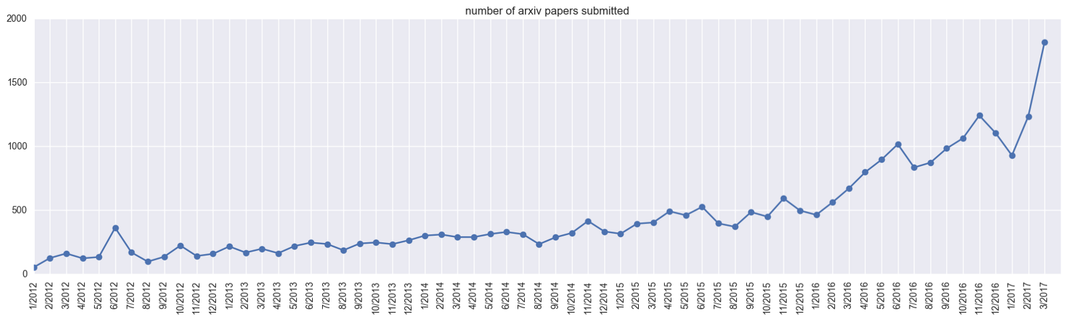
Historical Trends
ArXiv papers on deep learning: 2012-2017
ArXiv papers on deep learning: 2012-2017

Slide 21
Outline
Description of the course
Introduction to Artificial Neural Networks
Review of Machine Leaning. Classification and Logistic Regression
Introduction to Optimization
Gradient Descent
Stochastic Gradient Descent
Back Propagation
Single Neuron Network (‘Perceptron’)
Multi-Layer Perceptron

Slide 22
Machine Learning

Slide 23
Classification and Logistic Regression

Slide 24
Classification
Methods that are centered around modeling and prediction of a quantitative response variable (ex, number of taxi pickups, number of bike rentals, etc) are called regressions (and Ridge, LASSO, etc).
When the response variable is categorical, then the problem is no longer called a regression problem but is instead labeled as a classification problem.
The goal is to attempt to classify each observation into a category (aka, class or cluster) defined by Y, based on a set of predictor variables X.

Slide 25
Typical Classification Examples
The motivating examples for this lecture(s), homeworks and labs are based on classification. Classification problems are common in these domains:
Trying to determine where to set the cut-off for some diagnostic test (pregnancy tests, prostate or breast cancer screening tests, etc...)
Trying to determine if cancer has gone into remission based on treatment and various other indicators
Trying to classify patients into types or classes of disease based on various genomic markers

Slide 26
Data: Response vs. Predictor Variables
X
predictors
features
covariates
Y
outcome
response variable
dependent variable
TV | radio | newspaper | sales
230.1 | 37.8 | 69.2 | 22.1
44.5 | 39.3 | 45.1 | 10.4
17.2 | 45.9 | 69.3 | 9.3
151.5 | 41.3 | 58.5 | 18.5
180.8 | 10.8 | 58.4 | 12.9
n observations
p predictors

Slide 27
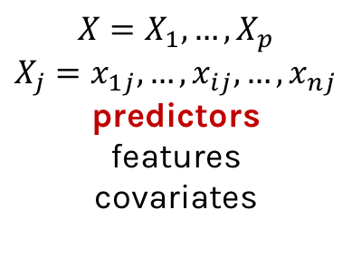
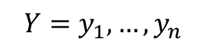
Response vs. Predictor Variables
$$X=X_{1},…,X_{p}$$
$$X_{j}=x_{1j},…,x_{ij},…,x_{nj}$$
predictors
features
covariates
outcome
response variable
dependent variable
$$Y=y_{1},…,y_{n}$$
TV | radio | newspaper | sales
230.1 | 37.8 | 69.2 | 22.1
44.5 | 39.3 | 45.1 | 10.4
17.2 | 45.9 | 69.3 | 9.3
151.5 | 41.3 | 58.5 | 18.5
180.8 | 10.8 | 58.4 | 12.9
n observations
p predictors

Slide 28
Heart Data
response variable Y
is Yes/No
Age | Sex | ChestPain | RestBP | Chol | Fbs | RestECG | MaxHR | ExAng | Oldpeak | Slope | Ca | Thal | AHD
63 | 1 | typical | 145 | 233 | 1 | 2 | 150 | 0 | 2.3 | 3 | 0.0 | fixed | No
67 | 1 | asymptomatic | 160 | 286 | 0 | 2 | 108 | 1 | 1.5 | 2 | 3.0 | normal | Yes
67 | 1 | asymptomatic | 120 | 229 | 0 | 2 | 129 | 1 | 2.6 | 2 | 2.0 | reversable | Yes
37 | 1 | nonanginal | 130 | 250 | 0 | 0 | 187 | 0 | 3.5 | 3 | 0.0 | normal | No
41 | 0 | nontypical | 130 | 204 | 0 | 2 | 172 | 0 | 1.4 | 1 | 0.0 | normal | No

Slide 29
Heart Data
These data contain a binary outcome HD for 303 patients who presented with chest pain. An outcome value of:
Yes indicates the presence of heart disease based on an angiographic test,
No means no heart disease.
There are 13 predictors including:
Age
Sex
Chol (a cholesterol measurement),
MaxHR
RestBP
and other heart and lung function measurements.

Slide 30
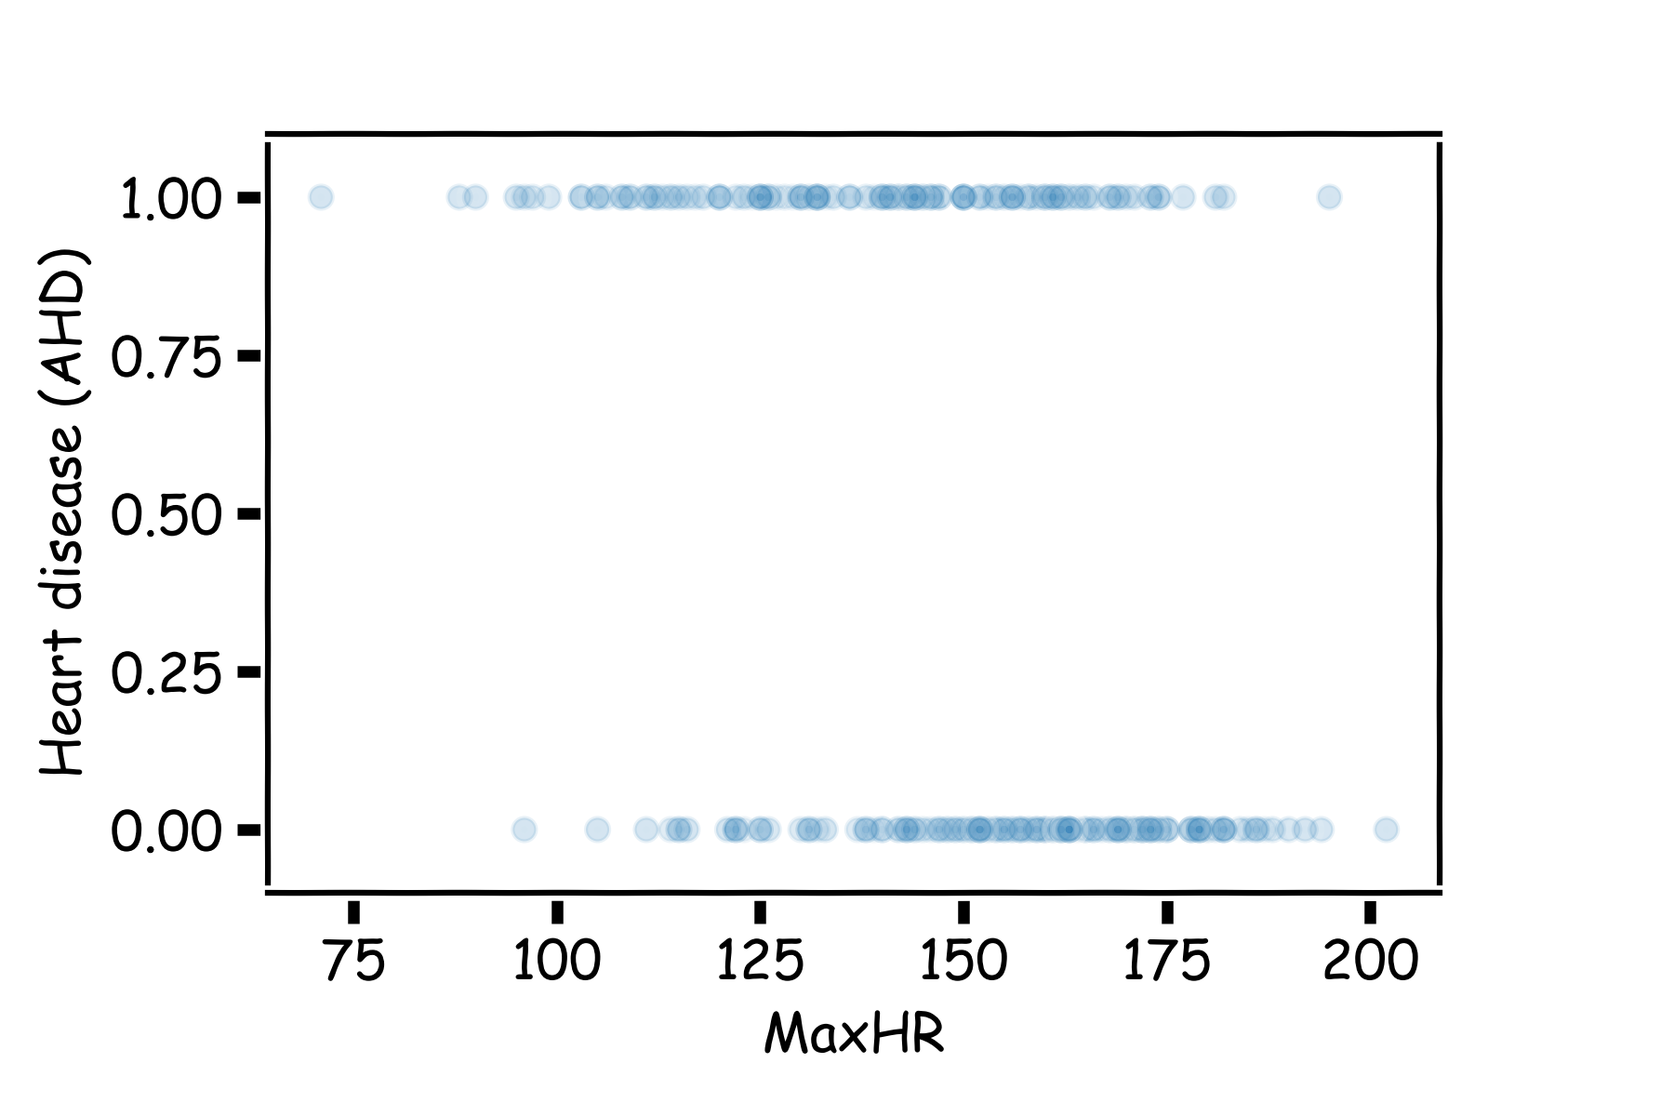
Heart Data: logistic estimation
We'd like to predict whether or not a person has a heart disease. And we'd like to make this prediction, for now, just based on the MaxHR.

Slide 31
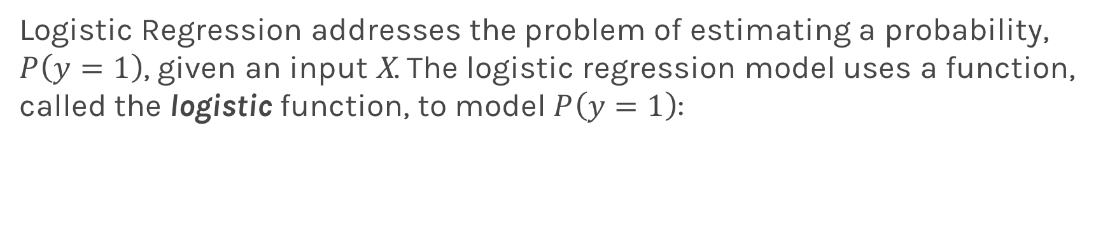
Logistic Regression
Logistic Regression addresses the problem of estimating a probability, $P\left(y=1\right)$, given an input X. The logistic regression model uses a function, called the logistic function, to model $P\left(y=1\right)$:

Slide 32
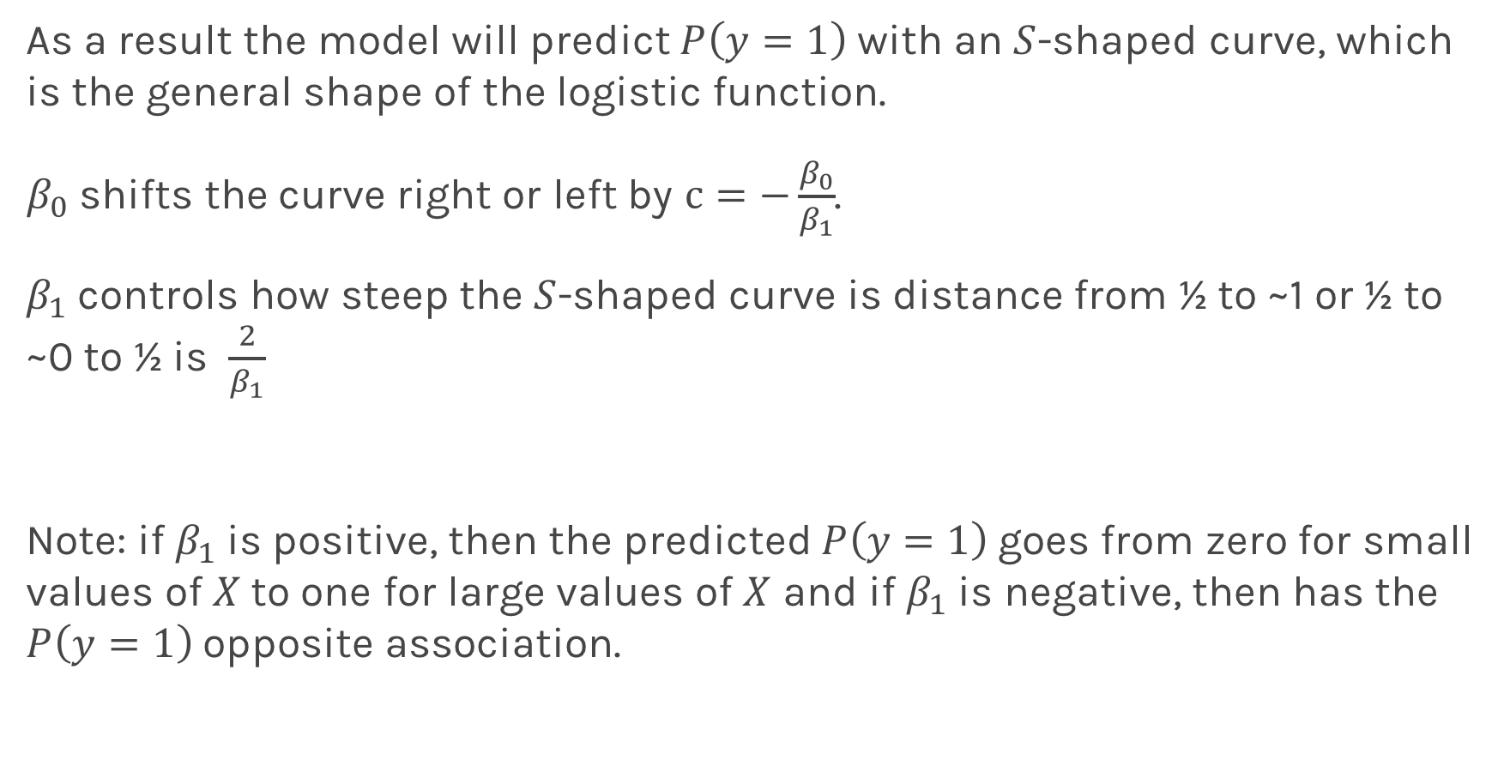
Logistic Regression
As a result the model will predict $P\left(y=1\right)$ with an $S$-shaped curve, which is the general shape of the logistic function.
$β_{0}$ shifts the curve right or left by $c=−\frac{β_{0}}{β_{1}}$.
$β_{1}$controls how steep the $S$-shaped curve is distance from ½ to ~1 or ½ to ~0 to ½ is $\frac{2}{β_{1}}$
Note: if $β_{1}$is positive, then the predicted $P\left(y=1\right)$goes from zero for small values of $X$to one for large values of $X$ and if $β_{1}$is negative, then has the $P\left(y=1\right)$opposite association.

Slide 33
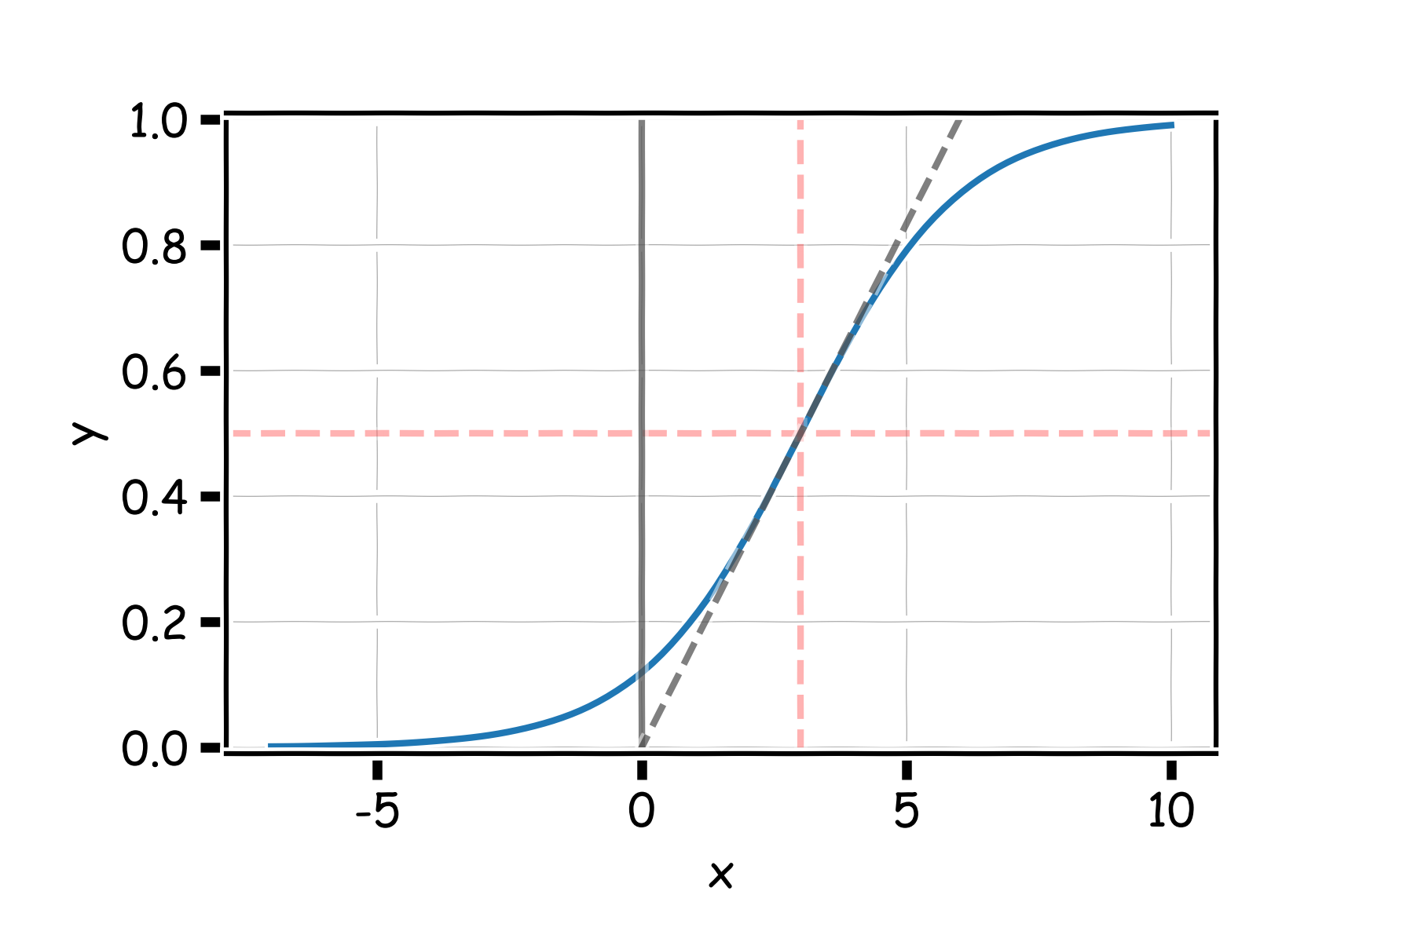
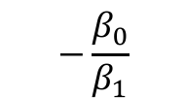

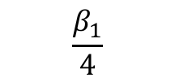
Logistic Regression
$$2β_{1}$$
$$−\frac{β_{0}}{β_{1}}$$
$$\frac{β_{1}}{4}$$

Slide 34
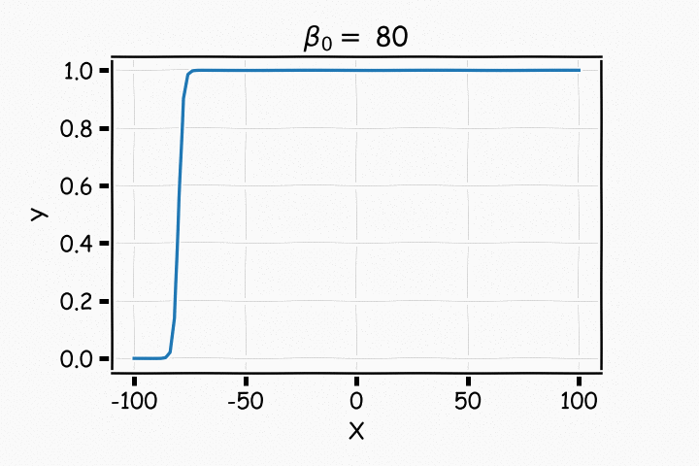
Logistic Regression

Slide 35
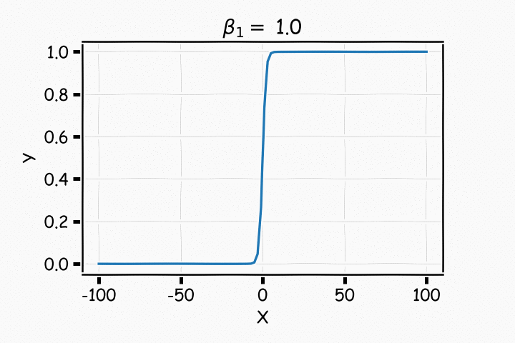
Logistic Regression

Slide 36
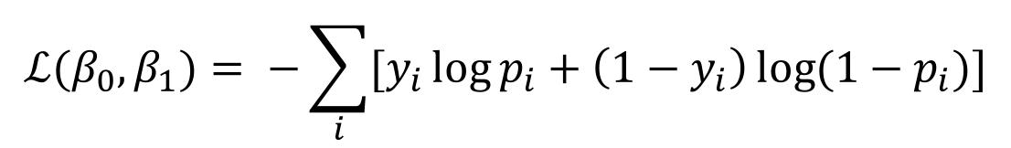
Estimating the coefficients for Logistic Regression
Find the coefficients that minimize the loss function
$$ℒ(β_{0}, β_{1})= −\sum_{i}{[y_{i}\log{p_{i}+\left(1−y_{i}\right)\log{(1−p_{i})]}}}$$
There are various ways to fit a logistic model to this data set in Python. The most straightforward in sklearn is via linear_model.LogisticRegression. A little bit of preprocessing work may need to be done first.

Slide 37
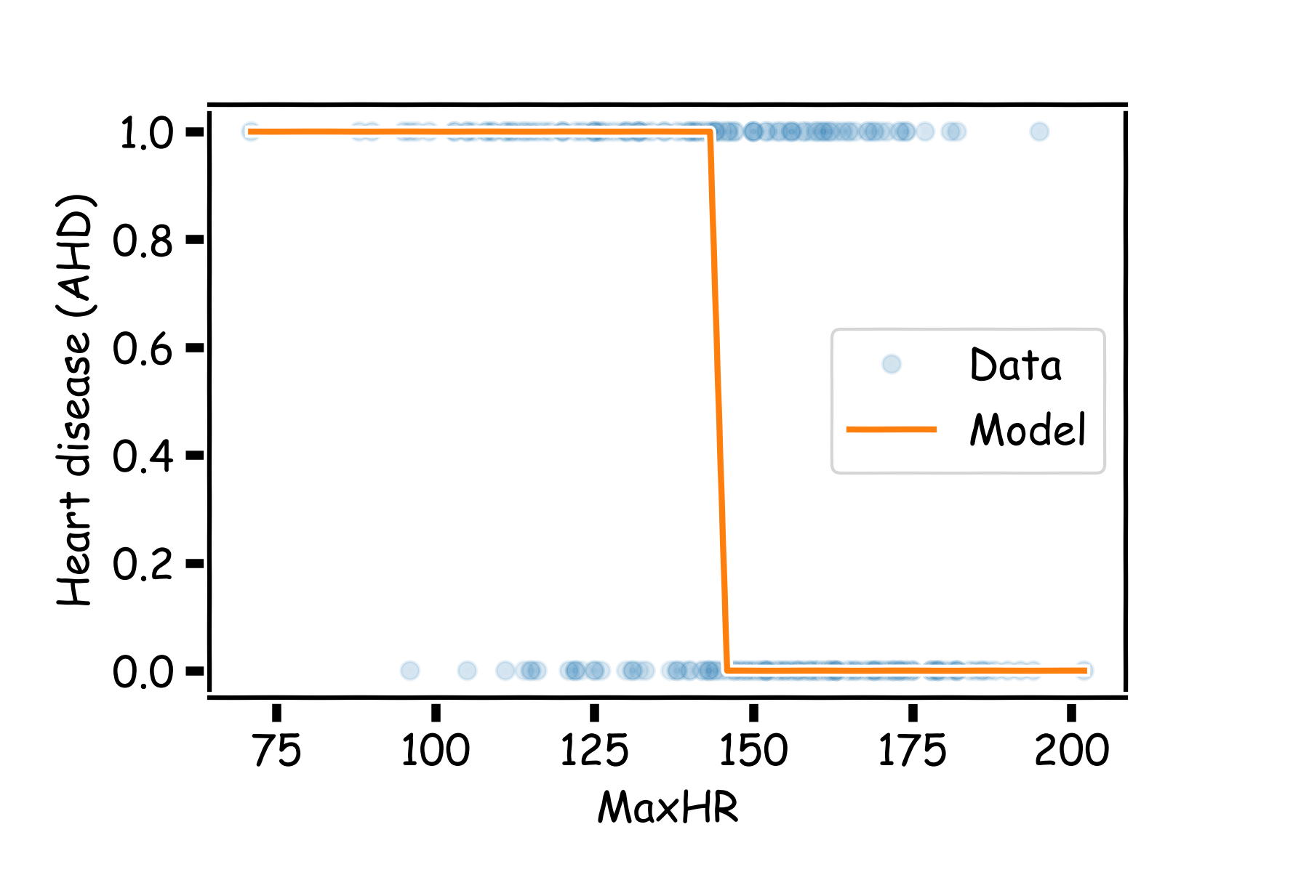
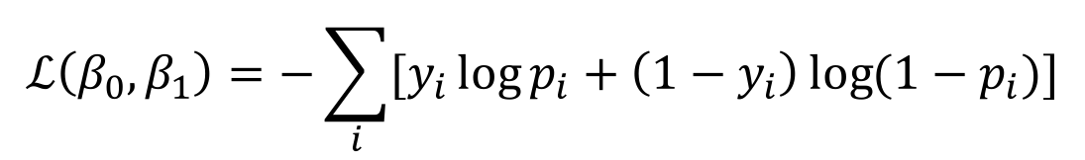
Estimating the coefficients for Logistic Regression
Find the coefficients that minimize the loss function
$$ℒ\left(β_{0}, β_{1}\right)=−\sum_{i}{[y_{i}\log{p_{i}+\left(1−y_{i}\right)\log{(1−p_{i})]}}}$$

Slide 38
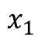
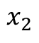
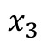
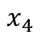
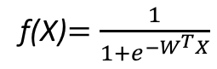
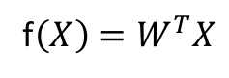
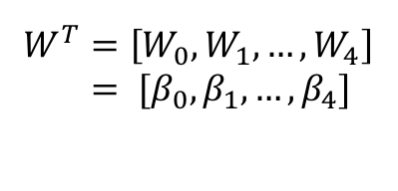
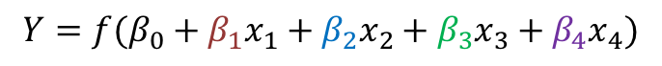
But what is the idea?
Start with Regression or Logistic Regression
Classification
Regression
f(X)$=\frac{1}{{1+e}^{−W^{T}X}}$
f$\left(X\right)=W^{T}X$
$$W^{T}=\left[W_{0},W_{1},…, W_{4}\right]$$
$= [β_{0}, β_{1},…, β_{4}]$
$$x_{1}$$
$$x_{2}$$
$$Y=f(β_{0}+β_{1}x_{1}+β_{2}x_{2}+β_{3}x_{3}+β_{4}x_{4})$$
$$x_{3}$$
$$x_{4}$$
Intercept or Bias
Coefficients or Weights

Slide 39
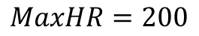
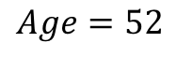
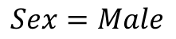
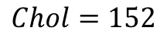
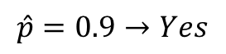
But what is the idea?
Start with all randomly selected weights. Most likely it will perform horribly.
For example, in our heart data, the model will be giving us the wrong answer.
$$MaxHR=200$$
Correct
$$Age=52$$
$$\hat{p}=0.9→Yes$$
y=No
$$Sex=Male$$
$$Chol=152$$
Bad Computer

Slide 40
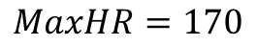
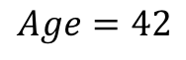
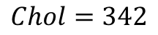
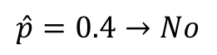
But what is the idea?
Start with all randomly selected weights. Most likely it will perform horribly.
For example, in our heart data, the model will be giving us the wrong answer.
$$MaxHR=170$$
Correct
$$Age=42$$
$$\hat{p}=0.4→No$$
y=Yes
$$Sex=Male$$
$$Chol=342$$
Bad Computer

Slide 41
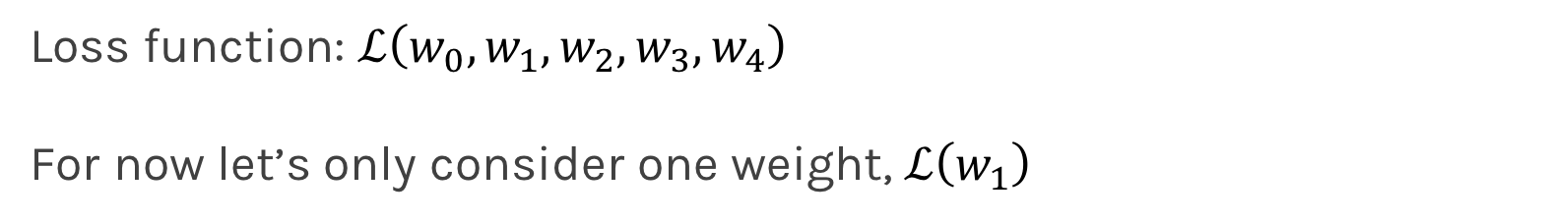
But what is the idea?
Loss Function: Takes all of these results and averages them and tells us how bad or good the computer or those weights are.
Telling the computer how bad or good is, does not help.
You want to tell it how to change those weights so it gets better.
Loss function: $ℒ\left(w_{0},w_{1},w_{2},w_{3},w_{4}\right)$
For now let’s only consider one weight, $ℒ\left(w_{1}\right)$

Slide 42
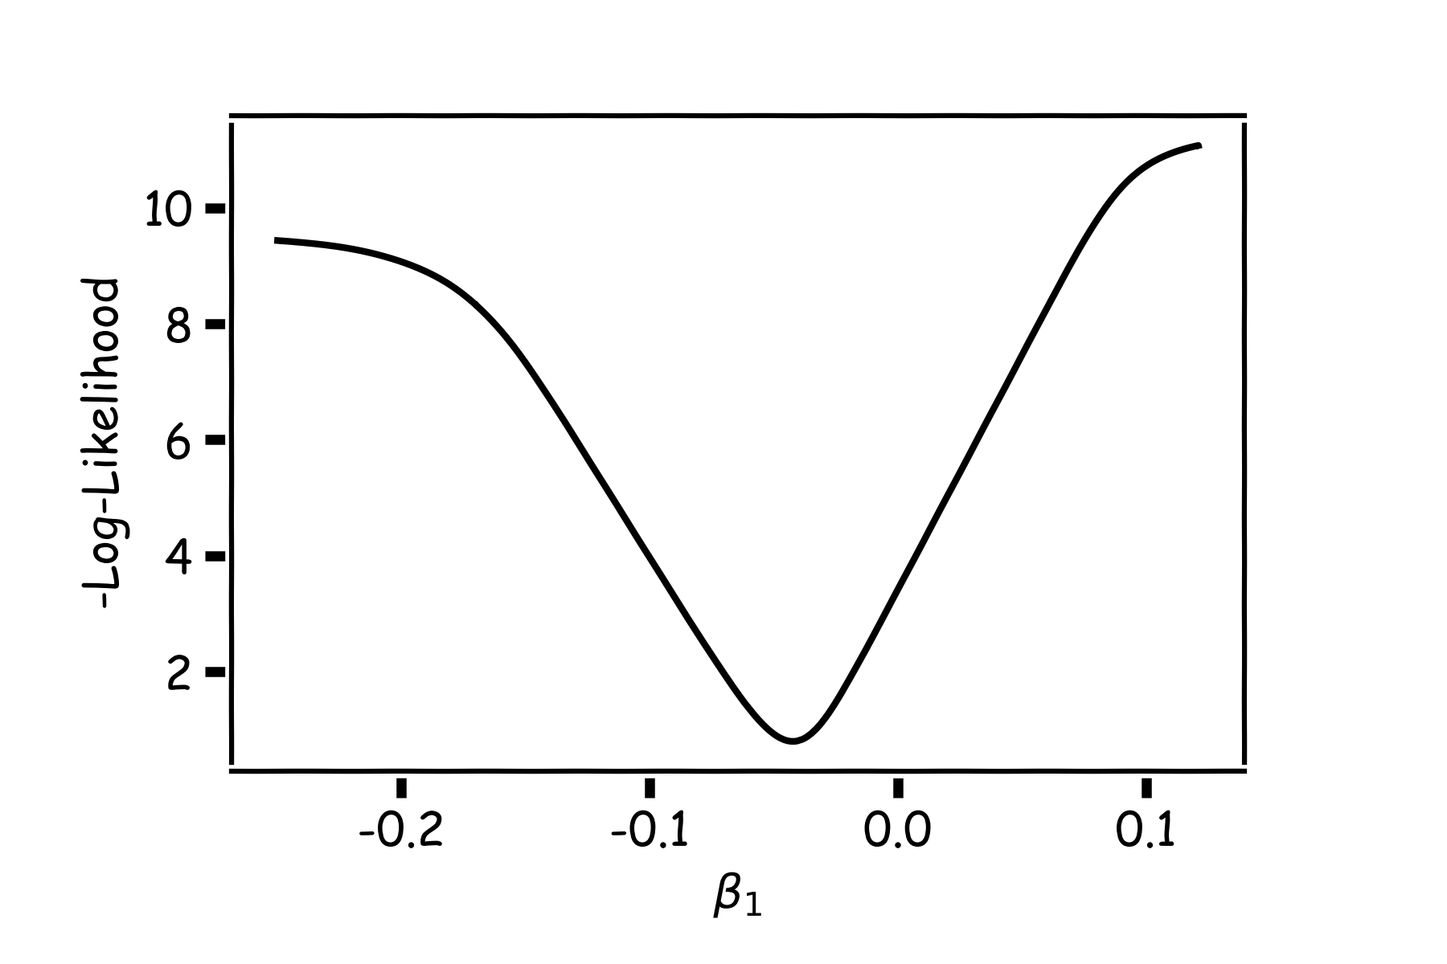
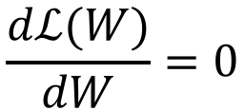
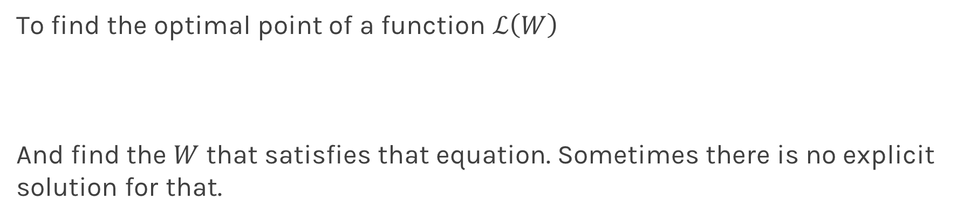
Minimizing the Loss function
Ideally we want to know the value of $w_{1}$ that gives the minimul $ℒ\left(W\right)$
To find the optimal point of a function $ℒ\left(W\right)$
And find the $W$ that satisfies that equation. Sometimes there is no explicit solution for that.
$$\frac{dℒ(W)}{dW}=0$$

Slide 43
Minimizing the Loss function
A more flexible method is
Start from any point
Determine which direction to go to reduce the loss direction (left or right)
Specifically if you can calculate the slope of the function at this point
Shift to the right if slope is negative or shift to the left if slope is positive
Repeat

Slide 44
Minimization of the Loss Function
If the step is proportional to the slope then you avoid overshooting the minimum.
Question: What is the mathematical function that describes the slope?
Question: How do we generalize this to more than one predictor?
Question: What do you think it is a good approach for telling the model how to change (what is the step size) to become better?

Slide 45
Minimization of the Loss Function
If the step is proportional to the slope then you avoid overshooting the minimum.
Question: What is the mathematical function that describes the slope? Derivative
Question: How do we generalize this to more than one predictor?
Take the derivative with respect to each coefficient and do the same sequentially
Question: What do you think it is a good approach for telling the model how to change (what is the step size) to become better?

Slide 46
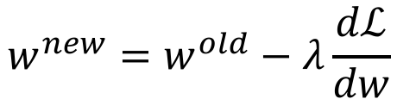
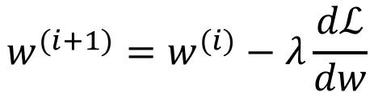
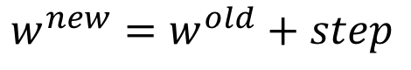
Let’s play the Pavlos game
We know that we want to go in the opposite direction of the derivative and we know we want to be making a step proportionally to the derivative.
Making a step means:
$${w^{new}=w}^{old}+step$$
Opposite direction of the derivative means:
$${w^{new}=w}^{old}−λ\frac{dℒ}{dw}$$
Learning Rate
Change to more conventional notation:
$${w^{(i+1)}=w}^{(i)}−λ\frac{dℒ}{dw}$$

Slide 47
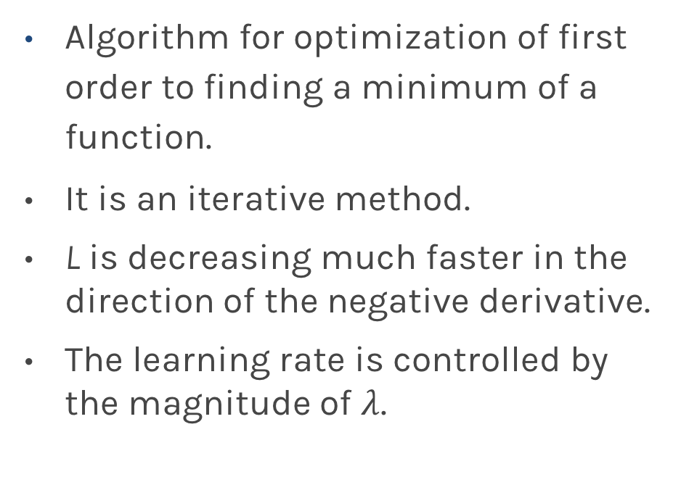
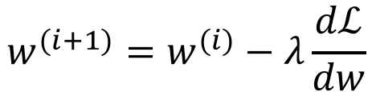
Gradient Descent
Algorithm for optimization of first order to finding a minimum of a function.
It is an iterative method.
L is decreasing much faster in the direction of the negative derivative.
The learning rate is controlled by the magnitude of $λ$.
$${w^{(i+1)}=w}^{(i)}−λ\frac{dℒ}{dw}$$
L
-
+
w

Slide 48
Considerations
We still need to calculate the derivatives.
We need to know what is the learning rate or how to set it.
Local vs global minima.
The full likelihood function includes summing up all individual ‘errors’. Unless you are a statistician, sometimes this includes hundreds of thousands of examples.

Slide 49
Derivatives: Memories from middle school

Slide 50
Linear Regression

Slide 51
Logistic Regression
Can you do it?
Wolfram Alpha can do it for us!
We need a formalism to deal with these derivatives.

Slide 52
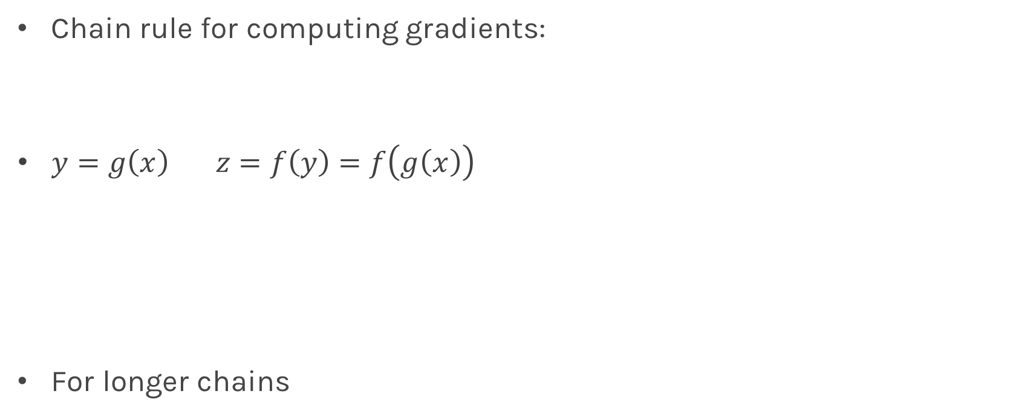
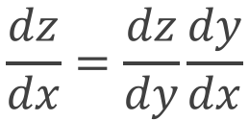
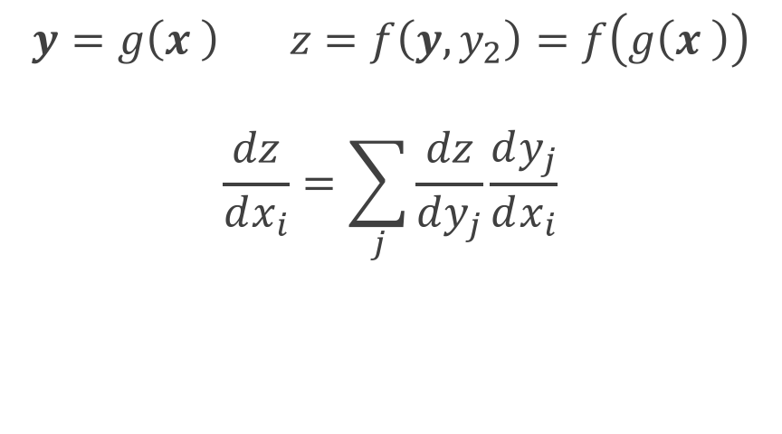
Chain Rule
Chain rule for computing gradients:
$y=g\left(x\right) z=f\left(y\right)=f\left(g\left(x\right)\right)$
For longer chains
$$y=g\left(x \right) z=f\left(y,y_{2}\right)=f\left(g\left(x \right)\right)$$
$$\frac{dz}{dx_{i}}=\sum_{j}{\frac{dz}{dy_{j}}\frac{dy_{j}}{dx_{i}}}$$
$$\frac{dz}{dx}=\frac{dz}{dy}\frac{dy}{dx}$$

Slide 53
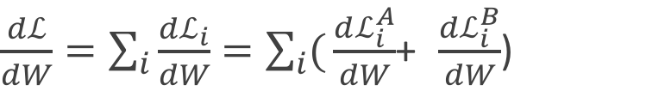
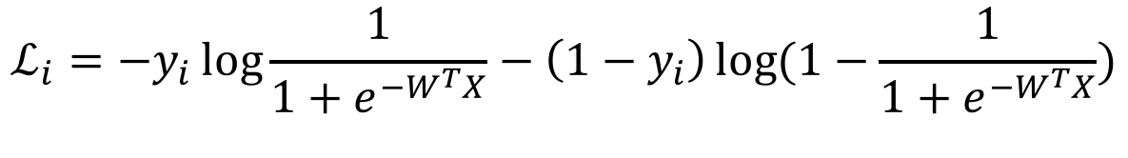


Logistic Regression derivatives
For logistic regression, the log of the loss function is:
$$ℒ=\sum_{i}{ℒ_{i}}=−\sum_{i}{\log{L_{i}}}{=−\sum_{i}{[y_{i}\log{p_{i}+\left(1−y_{i}\right)\log{(1−p_{i})]}}}}$$
$$ℒ_{i}={−y}_{i}\log{\frac{1}{1+e^{−W^{T}X}}−\left(1−y_{i}\right)\log{(1−\frac{1}{1+e^{−W^{T}X}})}}$$
To simplify the analysis let us split it into two parts,
$$ℒ_{i}=ℒ_{i}^{A}+ℒ_{i}^{B}$$
So the derivative with respect to W is:
$\frac{dℒ}{dW}=\sum_{i}{\frac{dℒ_{i}}{dW}}=\sum_{i}{(}\frac{dℒ_{i}^{A}}{dW}$+ $\frac{dℒ_{i}^{B}}{dW}$)

Slide 54


$$ℒ_{i}^{A}={−y}_{i}\log{\frac{1}{1+e^{−W^{T}X}}}$$
Variables | Partial derivatives | Partial derivatives
$$ξ_{1}=−W^{T}X$$ | $$\frac{dξ_{1}}{dW}=−X$$ | $$\frac{dξ_{1}}{dW}=−X$$
$$ξ_{2}={e^{ξ_{1}}=e}^{−W^{T}X}$$ | $$\frac{dξ_{2}}{dξ_{1}}=e^{ξ_{1}}$$ | $$\frac{dξ_{2}}{dξ_{1}}=e^{−W^{T}X}$$
$$ξ_{3}=1+ξ_{2}=1+e^{−W^{T}X}$$ | $$\frac{dξ_{3}}{dξ_{2}}=1$$ | $\frac{dξ_{3}}{dξ_{2}}=$1
$$ξ_{4}=\frac{1}{ξ_{3}}=\frac{1}{1+e^{−W^{T}X}}=p$$ | $$\frac{dξ_{4}}{dξ_{3}}=−\frac{1}{ξ_{3}^{2}}$$ | $$\frac{dξ_{4}}{dξ_{3}}=−\frac{1}{{\left(1+e^{−W^{T}X}\right)}^{2}}$$
$$ξ_{5}=\log{ξ_{4}=\log{p =}\log{\frac{1}{1+e^{−W^{T}X}}}}$$ | $$\frac{dξ_{5}}{dξ_{4}}=\frac{1}{ξ_{4}}$$ | $$\frac{dξ_{5}}{dξ_{4}}=1+e^{−W^{T}X}$$
$$ℒ_{i}^{A}=−yξ_{5}$$ | $$\frac{dℒ}{dξ_{5}}=−y$$ | $$\frac{dℒ}{dξ_{5}}=−y$$
$$\frac{dℒ_{i}^{A}}{dW}=\frac{dℒ_{i}}{dξ_{5}}\frac{dξ_{5}}{dξ_{4}}\frac{dξ_{4}}{dξ_{3}}\frac{dξ_{3}}{dξ_{2}}\frac{dξ_{2}}{dξ_{1}}\frac{dξ_{1}}{dW}$$ |  | $${\frac{dℒ_{i}^{A}}{dW}=−yXe}^{−W^{T}X}\frac{1}{{\left(1+e^{−W^{T}X}\right)}^{}}$$

Slide 55


$$ℒ_{i}^{B}={−(1−y}_{i})\log{[1−\frac{1}{1+e^{−W^{T}X}}]}$$
Variables | derivatives | Partial derivatives wrt to X,W
$$ξ_{1}=−W^{T}X$$ | $$\frac{dξ_{1}}{dW}=−X$$ | $$−X$$
$$ξ_{2}={e^{ξ_{1}}=e}^{−W^{T}X}$$ | $$\frac{dξ_{2}}{dξ_{1}}=e^{ξ_{1}}$$ | $$e^{−W^{T}X}$$
$$ξ_{3}=1+ξ_{2}=1+e^{−W^{T}X}$$ | $$\frac{dξ_{3}}{dξ_{2}}=1$$ | 1
$$ξ_{4}=\frac{1}{ξ_{3}}=\frac{1}{1+e^{−W^{T}X}}=p$$ | $$\frac{dξ_{4}}{dξ_{3}}=−\frac{1}{ξ_{3}^{2}}$$ | $$−\frac{1}{{\left(1+e^{−W^{T}X}\right)}^{2}}$$
$$ξ_{5}=1−ξ_{4}=1−\frac{1}{1+e^{−W^{T}X}}$$ | $$\frac{dξ_{5}}{dξ_{4}}=−1$$ | -1
$$ξ_{6}=\log{ξ_{5}=\log{(1−p) =}\log{\frac{1}{1+e^{−W^{T}X}}}}$$ | $$\frac{dξ_{6}}{dξ_{5}}=\frac{1}{ξ_{5}}$$ | $$\frac{1+e^{−W^{T}X} }{e^{−W^{T}X}}$$
$$ℒ_{i}^{B}=(1−y)ξ_{6}$$ | $$\frac{dℒ}{dξ_{5}}=1−y$$ | $$1−y$$
$$\frac{dℒ_{i}^{B}}{dW}=\frac{dℒ_{i}}{dξ_{6}}\frac{dξ_{6}}{dξ_{5}}\frac{dξ_{5}}{dξ_{4}}\frac{dξ_{4}}{dξ_{3}}\frac{dξ_{3}}{dξ_{2}}\frac{dξ_{2}}{dξ_{1}}\frac{dξ_{1}}{dW}$$ |  | $$(1−y)X\frac{1}{{\left(1+e^{−W^{T}X}\right)}^{}}$$

Slide 56
Learning Rate

Slide 57

Learning Rate
Trial and Error.
There are many alternative methods which address how to set or adjust the learning rate, using the derivative or second derivatives and or the momentum. To be discussed in the next lectures.
J. Nocedal y S. Wright, “Numerical optimization”, Springer, 1999 🔗
TLDR: J. Bullinaria, “Learning with Momentum, Conjugate Gradient Learning”, 2015 🔗

Slide 58
Local and Global minima

Slide 59
Local vs Global Minima
L
𝛉

Slide 60
Local vs Global Minima
L
𝛉

Slide 61
Local vs Global Minima
No guarantee that we get the global minimum.
Question: What would be a good strategy?

Slide 62
Large data

Slide 63


Batch and Stochastic Gradient Descent
$$ℒ=−\sum_{i}{[y_{i}\log{p_{i}+\left(1−y_{i}\right)\log{(1−p_{i})]}}}$$
Instead of using all the examples for every step, use a subset of them (batch).
For each iteration k, use the following loss function to derive the derivatives:
which is an approximation to the full Loss function.
$$ℒ^{k}=−\sum_{i∈b^{k}}{[y_{i}\log{p_{i}+\left(1−y_{i}\right)\log{(1−p_{i})]}}}$$

Slide 64
Batch and Stochastic Gradient Descent
Full Likelihood:
L
Batch Likelihood:
𝛉

Slide 65
Batch and Stochastic Gradient Descent
Full Likelihood:
L
Batch Likelihood:
𝛉

Slide 66
Batch and Stochastic Gradient Descent
Full Likelihood:
L
Batch Likelihood:
𝛉

Slide 67
Batch and Stochastic Gradient Descent
Full Likelihood:
L
Batch Likelihood:
𝛉

Slide 68
Batch and Stochastic Gradient Descent
Full Likelihood:
L
Batch Likelihood:
𝛉

Slide 69
Batch and Stochastic Gradient Descent
Full Likelihood:
L
Batch Likelihood:
𝛉

Slide 70
Batch and Stochastic Gradient Descent
Full Likelihood:
L
Batch Likelihood:
𝛉

Slide 71
Batch and Stochastic Gradient Descent
Full Likelihood:
L
Batch Likelihood:
𝛉

Slide 72
Batch and Stochastic Gradient Descent
Full Likelihood:
L
Batch Likelihood:
𝛉

Slide 73












Logistic Regression Revisited
Affine
Activation
Loss Fun
$$p_{i}=\frac{1}{1+e^{−h_{i}}}$$
$$x_{i}$$
$$h_{i}=β_{0}+β_{1}x_{i}$$
$$ℒ_{i}\left(β\right)=−y_{i}\ln\left(p_{i}\right)−\left(1−y_{i}\right)ln⁡(1−p_{i})$$
Affine
Activation
Loss Fun
$$p_{i}=\frac{1}{1+e^{−h_{k}}}$$
$$x_{k}$$
$$h_{k}=β_{0}+β_{1}x_{k}$$
$$ℒ_{k}\left(β\right)=−y_{k}\ln\left(p_{k}\right)−\left(1−y_{k}\right)ln⁡(1−p_{k})$$
…
Affine
Activation
Loss Fun
$$ℒ(β)=\sum_{i}^{n}{ℒ_{i}\left(β\right)}$$
$$p=\frac{1}{1+e^{−h}}$$
$$X$$
$$h=β_{0}+β_{1}X$$

Slide 74











Build our first ANN
Affine
Activation
Loss Fun
$$ℒ(β)=\sum_{i}^{n}{ℒ_{i}\left(β\right)}$$
$$p=\frac{1}{1+e^{−h}}$$
$$X$$
$$h=β_{0}+β_{1}X$$
Affine
Activation
Loss Fun
$$ℒ(β)=\sum_{i}^{n}{ℒ_{i}\left(β\right)}$$
$$p=\frac{1}{1+e^{−h}}$$
$$X$$
$$h=Xβ$$
Affine
Activation
Loss Fun
$$ℒ(W)=\sum_{i}^{n}{ℒ_{i}\left(W\right)}$$
$$y=\frac{1}{1+e^{−h}}$$
$$X$$
$$h=XW$$

Slide 75





Build our first ANN
Affine
Activation
Loss Fun
$$ℒ(W)=\sum_{i}^{n}{ℒ_{i}\left(W\right)}$$
$$p=\frac{1}{1+e^{−h}}$$
$$X$$
$$h=XW$$
$$X$$
$$Y$$
Single Neuron Network
Very similar to Perceptron

Slide 76

Example Using Heart Data
Slightly modified data to illustrate concepts.

Slide 77



Example Using Heart Data
$$X$$
$$Y$$

Slide 78






Example
$$X$$
$Y$’
$$X$$
$$Y$$

Slide 79








Pavlos game #232
W₁
W₁
$$X$$
$$Y$$
$$h_{1}$$
$$h_{1}+h_{2}$$
$$X$$
W₂
W₂
$$h_{2}$$
$$X$$
$$Y′$$

Slide 80


Pavlos game #232
$$q= W_{31}h_{1}+{W_{32}h}_{2}+W_{30}$$
W₁
W₁
$$X$$
$$Y$$
$$h_{1}$$
$$W_{3}$$
$$X$$
W₂
W₂
$$h_{2}$$
$$X$$
$$Y$$

Slide 81



Pavlos game #232
$$q= W_{31}h_{1}+{W_{32}h}_{2}+W_{30}$$
$$p=\frac{1}{1+e^{−q}}$$
W₁
W₁
$$X$$
$$Y$$
$$h_{1}$$
$$W_{3}$$
$$X$$
W₂
W₂
$$h_{2}$$
$$X$$
$$Y$$
$$L=−y ln\left(p\right)−\left(1−y\right)ln(1−p)$$
Need to learn W1, W2 and W3.

Slide 82
Backpropagation

Slide 83








Backpropagation: Logistic Regression Revisited
Affine
Activation
Loss Fun
$$ℒ(β)=\sum_{i}^{n}{ℒ_{i}\left(β\right)}$$
$$p=\frac{1}{1+e^{−h}}$$
$$X$$
$$h=β_{0}+β_{1}X$$
$\frac{∂ℒ}{∂p}$ $\frac{∂p}{∂h}$ $\frac{∂h}{∂β}$
$\frac{∂ℒ}{∂p}$ $\frac{∂p}{∂h}$
$$\frac{∂ℒ}{∂p}$$
$$\frac{∂h}{∂β_{1}}=X,\frac{dℒ}{dβ_{0}}=1$$
$$\frac{∂p}{∂h}=σ(h)(1−σ\left(h\right))$$
$$\frac{∂ℒ}{∂p}=−y\frac{1}{p}−\left(1−y\right)\frac{1}{1−p}$$
$$\frac{∂ℒ}{∂β_{1}}=−Xσ\left(h\right)\left(1−σ\left(h\right)\right)y\frac{1}{p}+\left(1−y\right)\frac{1}{1−p}]$$
$$\frac{∂ℒ}{∂β_{0 }}=−σ\left(h\right)\left(1−σ\left(h\right)\right)[ y\frac{1}{p}+\left(1−y\right)\frac{1}{1−p}]$$

Slide 84



Backpropagation
These derivatives need to be evaluated at some values of X,y and W.
But since we have an expression, we can build a function that takes as input X,y,W and returns the derivatives and then use gradient descent to update.
This approach works well but it does not generalize. For example if the network is different we need to write a new function to evaluate the derivatives.
For example this network will need a different function
W₁
$$W_{3}$$
$$X$$
$$Y$$
W₂

Slide 85





Backpropagation
These derivatives need to be evaluated at some values of X,y and W.
But since we have an expression, we can build a function that takes as input X,y,W and returns the derivatives and then use gradient descent to update.
This approach works well but it does not generalize. For example if the network is different we need to write a new function to evaluate the derivatives.
For example this network will need a different function
W₁
$$W_{3}$$
$$W_{5}$$
$$X$$
$$Y$$
W₂
$$W_{4}$$

Slide 86

Backpropagation. Pavlos game #456
Need to find a formalism to calculate the derivatives of the loss wrt to weights that is:
Flexible enough that adding a node or a layer or changing something in the network won’t require to re-derive the functional form from scratch
It is exact
It is computationally efficient
Hints:
Remember we only need to evaluate the derivatives at $X_{i}, y_{i}$ and $W^{(k)}.$
We should take advantage of the chain rule we learned before

Slide 87

Idea 1: Evaluate the derivative at: X={3}, y=1, W=3
Variables | derivatives | Value of the variable | Value of the partial derivative | $$\frac{dξ_{n}}{dW}$$
$$ξ_{1}=−W^{T}X$$ | $$\frac{∂ξ_{1}}{∂W}=−X$$ | $$−9$$ | -3 | -3
$$ξ_{2}={e^{ξ_{1}}=e}^{−W^{T}X}$$ | $$\frac{∂ξ_{2}}{∂ξ_{1}}=e^{ξ_{1}}$$ | $$e^{−9}$$ | $$e^{−9}$$ | -3$e^{−9}$
$$ξ_{3}=1+ξ_{2}=1+e^{−W^{T}X}$$ | $$\frac{∂ξ_{3}}{∂ξ_{2}}=1$$ | 1+$e^{−9}$ | 1 | -3$e^{−9}$
$$ξ_{4}=\frac{1}{ξ_{3}}=\frac{1}{1+e^{−W^{T}X}}=p$$ | $$\frac{∂ξ_{4}}{∂ξ_{3}}=−\frac{1}{ξ_{3}^{2}}$$ | $$\frac{1}{1+e^{−9}}$$ | $${\left(\frac{1}{1+e^{−9}}\right)}^{2}$$ | -3$e^{−9}{\left(\frac{1}{1+e^{−9}}\right)}^{2}$
$$ξ_{5}=\log{ξ_{4}=\log{p =}\log{\frac{1}{1+e^{−W^{T}X}}}}$$ | $$\frac{∂ξ_{5}}{∂ξ_{4}}=\frac{1}{ξ_{4}}$$ | $$\log{\frac{1}{1+e^{−9}}}$$ | $$1+e^{−9}$$ | -3$e^{−9}{\left(\frac{1}{1+e^{−9}}\right)}^{}$
$$ℒ_{i}^{A}=−yξ_{5}$$ | $$\frac{∂ℒ}{∂ξ_{5}}=−y$$ | $$−\log{\frac{1}{1+e^{−9}}}$$ | $$−1$$ | 3$e^{−9}{\left(\frac{1}{1+e^{−9}}\right)}^{}$
$$\frac{dℒ_{i}^{A}}{dW}=\frac{dℒ_{i}}{dξ_{5}}\frac{dξ_{5}}{dξ_{4}}\frac{dξ_{4}}{dξ_{3}}\frac{dξ_{3}}{dξ_{2}}\frac{dξ_{2}}{dξ_{1}}\frac{dξ_{1}}{dW}$$ |  |  | $$−3$$ | 0.00037018372

Slide 88

Basic functions
We still need to derive derivatives ☹
Variables | derivatives | Value of the variable | Value of the partial derivative | $$\frac{dξ_{n}}{dW}$$
$$ξ_{1}=−W^{T}X$$ | $$\frac{dξ_{1}}{dW}=−X$$ | $$−9$$ | -3 | -3
$$ξ_{2}={e^{ξ_{1}}=e}^{−W^{T}X}$$ | $$\frac{dξ_{2}}{dξ_{1}}=e^{ξ_{1}}$$ | $$e^{−9}$$ | $$e^{−9}$$ | -3$e^{−9}$
$$ξ_{3}=1+ξ_{2}=1+e^{−W^{T}X}$$ | $$\frac{dξ_{3}}{dξ_{2}}=1$$ | 1+$e^{−9}$ | 1 | -3$e^{−9}$
$$ξ_{4}=\frac{1}{ξ_{3}}=\frac{1}{1+e^{−W^{T}X}}=p$$ | $$\frac{dξ_{4}}{dξ_{3}}=−\frac{1}{ξ_{3}^{2}}$$ | $$\frac{1}{1+e^{−9}}$$ | $${\left(\frac{1}{1+e^{−9}}\right)}^{2}$$ | -3$e^{−9}{\left(\frac{1}{1+e^{−9}}\right)}^{2}$
$$ξ_{5}=\log{ξ_{4}=\log{p =}\log{\frac{1}{1+e^{−W^{T}X}}}}$$ | $$\frac{dξ_{5}}{dξ_{4}}=\frac{1}{ξ_{4}}$$ | $$\log{\frac{1}{1+e^{−9}}}$$ | $$1+e^{−9}$$ | -3$e^{−9}{\left(\frac{1}{1+e^{−9}}\right)}^{}$
$$ℒ_{i}^{A}=−yξ_{5}$$ | $$\frac{dℒ}{dξ_{5}}=−y$$ | $$−\log{\frac{1}{1+e^{−9}}}$$ | $$−1$$ | 3$e^{−9}{\left(\frac{1}{1+e^{−9}}\right)}^{}$
$$\frac{dℒ_{i}^{A}}{dW}=\frac{dℒ_{i}}{dξ_{5}}\frac{dξ_{5}}{dξ_{4}}\frac{dξ_{4}}{dξ_{3}}\frac{dξ_{3}}{dξ_{2}}\frac{dξ_{2}}{dξ_{1}}\frac{dξ_{1}}{dW}$$ |  |  | $$−3$$ | 0.00037018372

Slide 89

Basic functions
Notice though those are basic functions that my grandparent can do
$$ξ_{1}=−W^{T}X$$ | $$\frac{dξ_{1}}{dW}=−X$$ | Return a
$$ξ_{2}=e^{ξ_{1}}$$ | $$\frac{dξ_{2}}{dξ_{1}}=e^{ξ_{1}}$$ | return exp(x)
$$ξ_{3}=1+ξ_{2}$$ | $$\frac{dξ_{3}}{dξ_{2}}=1$$ | return 1
$$ξ_{4}=\frac{1}{ξ_{3}}$$ | $$\frac{dξ_{4}}{dξ_{3}}=−\frac{1}{ξ_{3}^{2}}$$ | Return -(1/x)**(-2)
$$ξ_{5}=\log{ξ_{4}}$$ | $$\frac{dξ_{5}}{dξ_{4}}=\frac{1}{ξ_{4}}$$ | Return
$$ℒ_{i}^{A}=−yξ_{5}$$ | $$\frac{dℒ}{dξ_{5}}=−y$$

Slide 90


Putting it altogether
We specify the network structure
W₁
$$W_{3}$$
$$X$$
$$W_{5}$$
$$Y$$
W₂
$$W_{4}$$
We create the computational graph …
What is computational graph?

Slide 91


















$$ξ_{5}=log{\frac{1}{1+e^{−W^{T}X}}}$$
Computational Graph
$$ξ_{4}=\frac{1}{1+e^{−W^{T}X}}$$
$$÷$$
Log
$$ξ_{7}=log(1−{\frac{1}{1+e^{−W^{T}X}})}$$
$$ξ_{3}={1+e}^{−W^{T}X}$$
$$+$$
log
-
1
$$exp$$
$$ξ_{6}=1−{\frac{1}{1+e^{−W^{T}X}}}$$
1-y
$$ξ_{2}=e^{−ξ_{1}} \\ ξ_{2}^{′}=$$
$$−$$
$$×$$
$$ξ_{1}=W^{T}X$$ $ξ_{1}^{′}$=X
y
$$×$$
$$×$$
$$ξ_{8}=\left(1−y\right)log(1−{\frac{1}{1+e^{−W^{T}X}})}$$
$$ξ_{9}=ylog({\frac{1}{1+e^{−W^{T}X}})}$$
W
X
$$+$$
$$ξ_{0}=W$$
$$−ℒ=ξ_{9}=ylog({\frac{1}{1+e^{−W^{T}X}})}+ \left(1−y\right)log(1−{\frac{1}{1+e^{−W^{T}X}})}$$

Slide 92
Putting it altogether
We specify the network structure
W₁
$$W_{3}$$
$$X$$
$$W_{5}$$
$$Y$$
W₂
$$W_{4}$$
We create the computational graph.
Each node of the graph we create
the function mode and the partial derivatives
Now we can either go forward or backward depending on the situation (in general) forward is easier to implement and to understand. The difference is cleared when there are multiple nodes per layer.

Slide 93

Forward mode: Evaluate the derivative at: X={3}, y=1, W=3
Variables | derivatives | Value of the variable | Value of the partial derivative | $$\frac{dξ_{n}}{dW}$$
$$ξ_{1}=−W^{T}X$$ | $$\frac{dξ_{1}}{dW}=−X$$ | $$−9$$ | -3 | -3
$$ξ_{2}={e^{ξ_{1}}=e}^{−W^{T}X}$$ | $$\frac{dξ_{2}}{dξ_{1}}=e^{ξ_{1}}$$ | $$e^{−9}$$ | $$e^{−9}$$ | -3$e^{−9}$
$$ξ_{3}=1+ξ_{2}=1+e^{−W^{T}X}$$ | $$\frac{dξ_{3}}{dξ_{2}}=1$$ | 1+$e^{−9}$ | 1 | -3$e^{−9}$
$$ξ_{4}=\frac{1}{ξ_{3}}=\frac{1}{1+e^{−W^{T}X}}=p$$ | $$\frac{dξ_{4}}{dξ_{3}}=−\frac{1}{ξ_{3}^{2}}$$ | $$\frac{1}{1+e^{−9}}$$ | $${\left(\frac{1}{1+e^{−9}}\right)}^{2}$$ | -3$e^{−9}{\left(\frac{1}{1+e^{−9}}\right)}^{2}$
$$ξ_{5}=\log{ξ_{4}=\log{p =}\log{\frac{1}{1+e^{−W^{T}X}}}}$$ | $$\frac{dξ_{5}}{dξ_{4}}=\frac{1}{ξ_{4}}$$ | $$\log{\frac{1}{1+e^{−9}}}$$ | $$1+e^{−9}$$ | -3$e^{−9}{\left(\frac{1}{1+e^{−9}}\right)}^{}$
$$ℒ_{i}^{A}=−yξ_{5}$$ | $$\frac{dℒ}{dξ_{5}}=−y$$ | $$−\log{\frac{1}{1+e^{−9}}}$$ | $$−1$$ | 3$e^{−9}{\left(\frac{1}{1+e^{−9}}\right)}^{}$
$$\frac{dℒ_{i}^{A}}{dW}=\frac{dℒ_{i}}{dξ_{5}}\frac{dξ_{5}}{dξ_{4}}\frac{dξ_{4}}{dξ_{3}}\frac{dξ_{3}}{dξ_{2}}\frac{dξ_{2}}{dξ_{1}}\frac{dξ_{1}}{dW}$$ |  |  | $$−3$$ | 0.00037018372

Slide 94

Backward mode: Evaluate the derivative at: X={3}, y=1, W=3
Variables | derivatives | Value of the variable | Value of the partial derivative | $$\frac{dξ_{n}}{dW}$$
$$ξ_{1}=−W^{T}X$$ | $$\frac{dξ_{1}}{dW}=−X$$ | $$−9$$ | -3 | -3
$$ξ_{2}={e^{ξ_{1}}=e}^{−W^{T}X}$$ | $$\frac{dξ_{2}}{dξ_{1}}=e^{ξ_{1}}$$ | $$e^{−9}$$ | $$e^{−9}$$ | -3$e^{−9}$
$$ξ_{3}=1+ξ_{2}=1+e^{−W^{T}X}$$ | $$\frac{dξ_{3}}{dξ_{2}}=1$$ | 1+$e^{−9}$ | 1 | -3$e^{−9}$
$$ξ_{4}=\frac{1}{ξ_{3}}=\frac{1}{1+e^{−W^{T}X}}=p$$ | $$\frac{dξ_{4}}{dξ_{3}}=−\frac{1}{ξ_{3}^{2}}$$ | $$\frac{1}{1+e^{−9}}$$ | $${\left(\frac{1}{1+e^{−9}}\right)}^{2}$$ | -3$e^{−9}{\left(\frac{1}{1+e^{−9}}\right)}^{2}$
$$ξ_{5}=\log{ξ_{4}=\log{p =}\log{\frac{1}{1+e^{−W^{T}X}}}}$$ | $$\frac{dξ_{5}}{dξ_{4}}=\frac{1}{ξ_{4}}$$ | $$\log{\frac{1}{1+e^{−9}}}$$ | $$1+e^{−9}$$ | -3$e^{−9}{\left(\frac{1}{1+e^{−9}}\right)}^{}$
$$ℒ_{i}^{A}=−yξ_{5}$$ | $$\frac{dℒ}{dξ_{5}}=−y$$ | $$−\log{\frac{1}{1+e^{−9}}}$$ | $$−1$$ | 3$e^{−9}{\left(\frac{1}{1+e^{−9}}\right)}^{}$
$$\frac{dℒ_{i}^{A}}{dW}=\frac{dℒ_{i}}{dξ_{5}}\frac{dξ_{5}}{dξ_{4}}\frac{dξ_{4}}{dξ_{3}}\frac{dξ_{3}}{dξ_{2}}\frac{dξ_{2}}{dξ_{1}}\frac{dξ_{1}}{dW}$$ |  |  | $$−3$$ | 0.00037018372

Slide 95
Artificial Neural Networks
Machine Learning Algorithm
Very simplified parametric models of our brain
Networks of basic processing units: neurons
Neurons store information which has to be learned
Many types of architectures to solve different tasks
They can scale to massive data
They can train in parallel
...
...
...
...
...
99.9%
dog

